Slide 1
Introduction to Statistical Models
Dr. Richard Kennedy

Slide 2
Aims
Understand characteristics of the normal distribution
Understand measures of central tendency and variability
Understand how confidence intervals and power relate to error rates and effect sizes

Slide 3
Analysing Data: Histograms
Frequency Distributions (aka Histograms)
A graph plotting values of observations on the horizontal axis, with a bar showing how many times each value occurred in the data set.
The ‘Normal’ Distribution
Bell shaped
Symmetrical around the centre

Slide 4
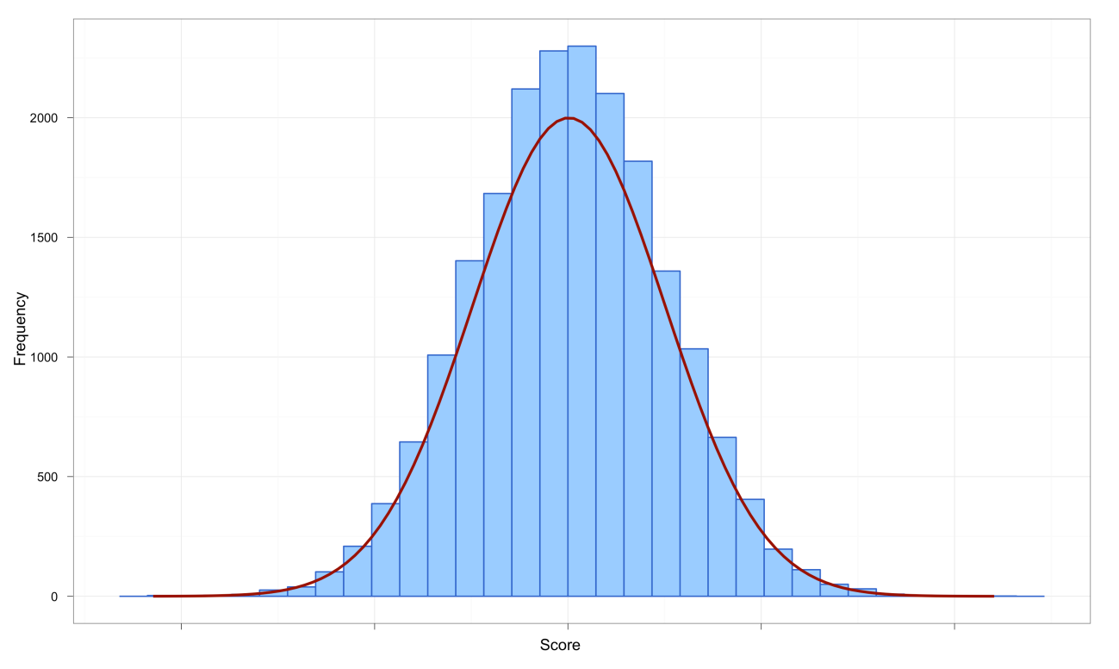
Normal Distribution
The curve shows the idealized shape.

Slide 5
Normal Distribution
Completely defined by two parameters, mean and variance
Mean: where the center of the data is located on the graph
Variance: the spread of data around the mean on the graph
A normal distribution with mean 0 and variance 1 is called a standard normal distribution

Slide 6
Z-scores
Z-scores
Standardizing a score with respect to the other scores in the group
Expresses a score in terms of how many standard deviations it is away from the mean
Converts a normal distribution to a standard normal distribution

Slide 7
Properties of z-scores
We convert from raw data to z-scores to put all data on the same scale
95% of z-scores lie between ±1.96
For normal distribution, this means 95% of the data lie within 1.96 standard devia-tions from the mean (mean ± 1.96 x SD)
99% of z-scores lie between ±2.58
99.9% of z-scores lie between ±3.29

Slide 8
Probability Density function of a Normal Distribution

Slide 9
Other Frequency Distributions
Bernoulli distribution
Single yes/no factor (category)
Binomial distribution
Multiple yes/no factors (categories)
Poisson distribution
Count data
t distribution
Uses sample variance rather than population variance

Slide 10
Properties of Frequency Distributions
Skew
The symmetry of the distribution.
Positive skew (scores bunched at low values with the tail pointing to high values)
Negative skew (scores bunched at high values with the tail pointing to low values)
Kurtosis
The ‘heaviness’ of the tails
Leptokurtic = heavy tails
Platykurtic = light tails

Slide 11
Skew
Skew will be one of the most common ways that data violate (do not follow) the normal distribution assumption
We’ll talk about ways to deal with this in later lectures

Slide 12
Kurtosis

Slide 13
Example Data
The American Gut Project (AGP; http://americangut.org)
Characterizes gut bacterial flora “in the wild”
15,096 samples from 11,336 self-selected human participants
Our examples are drawn from a random sample of 101 participants
We used the % of gut flora belonging to 4 common bacterial phyla
We have characteristics of human participants to examine associations with gut flora type

Slide 14
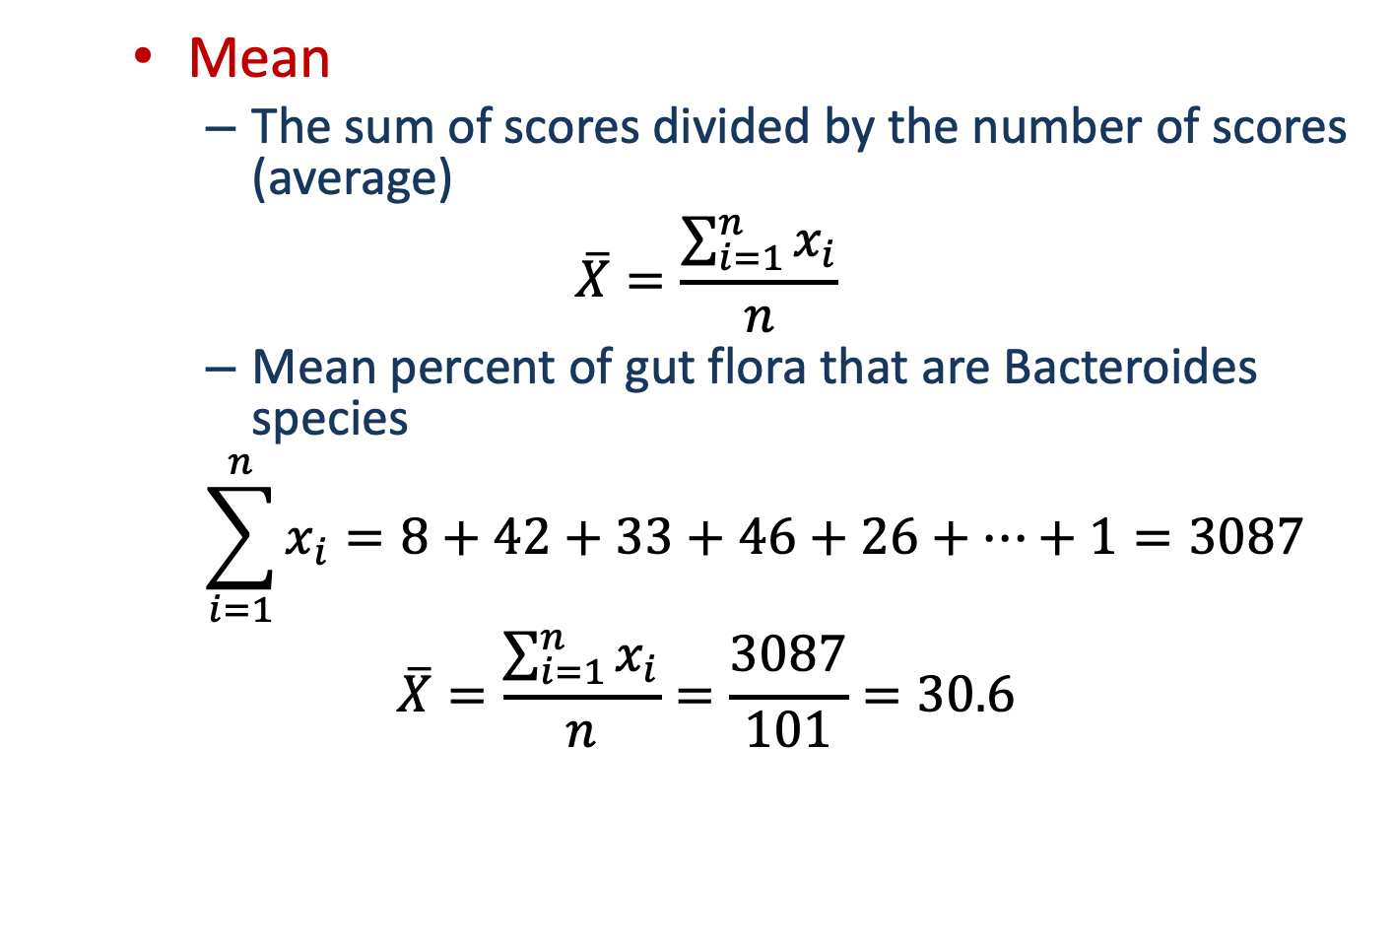
Central Tendency: Mean
Mean
The sum of scores divided by the number of scores (average)
$$\overline{X}=\frac{\sum_{i=1}^{n}{x_{i}}}{n}$$
Mean percent of gut flora that are Bacteroides species
$$\sum_{i=1}^{n}{x_{i}=8+42+33+46+26+…+1}=3087$$
$$\overline{X}=\frac{\sum_{i=1}^{n}{x_{i}}}{n}=\frac{3087}{101}=30.6$$

Slide 15
Central Tendency: Mode
Mode
The most frequent score
Bimodal
Having two modes
Multimodal
Having several modes

Slide 16
Bimodal and Multimodal Distributions

Slide 17
Central Tendency: Median
The Median is the middle score when scores are ordered:
Unordered data: 8, 42, 33, 46, 26, 16, 10, 49, 32, 35, 27, 49, 34, 26, 16,
28, 18, 23, 28, 1, 31, 24, 4, 28, 43, 24, 44, 68, 15, 26, 61, 23, 55, 24, 17,
57, 15, 9, 41, 43, 33, 44, 38, 11, 29, 42, 62, 30, 40, 31, 68, 34, 52, 34, 15,
21, 22, 24, 11, 27, 25, 33, 28, 32, 10, 5, 39, 31, 15, 40, 28, 32, 33, 64, 17,
27, 40, 36, 34, 2, 11, 32, 55, 30, 60, 47, 20, 78, 13, 30, 52, 35, 24, 4, 4, 44,
26, 33, 20, 30, 1
Ordered data: 1, 1, 2, 4, 4, 4, 5, 8, 9, 10, 10, 11, 11, 11, 13, 15, 15, 15,
15, 16, 16, 17, 17, 18, 20, 20, 21, 22, 23, 23, 24, 24, 24, 24, 24, 25, 26, 26,
26, 26, 27, 27, 27, 28, 28, 28, 28, 28, 29, 30, 30, 30, 30, 31, 31, 31, 32, 32,
32, 32, 33, 33, 33, 33, 33, 34, 34, 34, 34, 35, 35, 36, 38, 39, 40, 40, 40, 41,
42, 42, 43, 43, 44, 44, 44, 46, 47, 49, 49, 52, 52, 55, 55, 57, 60, 61, 62, 64,
68, 68, 78
Median = 30
101 values; 50 below and 50 above median

Slide 18
Dispersion: Range
Range
The smallest score subtracted from the largest
For our microbiome data the highest percentage is 78 and the lowest is 1; therefore the range is: 78 − 1 = 77

Slide 19
Dispersion:Interquartile Range
Quartiles
The three values that split the sorted data into four equal parts.
Second Quartile = median
Lower quartile = median of lower half of the data
Upper quartile = median of upper half of the data
1st Quartile
2nd Quartile (Median)
3rd Quartile
Ordered data: 1, 1, 2, 4, 4, 4, 5, 8, 9, 10, 10, 11, 11, 11, 13, 15, 15, 15,
15, 16, 16, 17, 17, 18, 20, 20, 21, 22, 23, 23, 24, 24, 24, 24, 24, 25, 26, 26,
26, 26, 27, 27, 27, 28, 28, 28, 28, 28, 29, 30, 30, 30, 30, 31, 31, 31, 32, 32,
32, 32, 33, 33, 33, 33, 33, 34, 34, 34, 34, 35, 35, 36, 38, 39, 40, 40, 40, 41,
42, 42, 43, 43, 44, 44, 44, 46, 47, 49, 49, 52, 52, 55, 55, 57, 60, 61, 62, 64,
68, 68, 78
Interquartile range = 3rd Quartile – 1st Quartile = 40 – 20 = 20

Slide 20
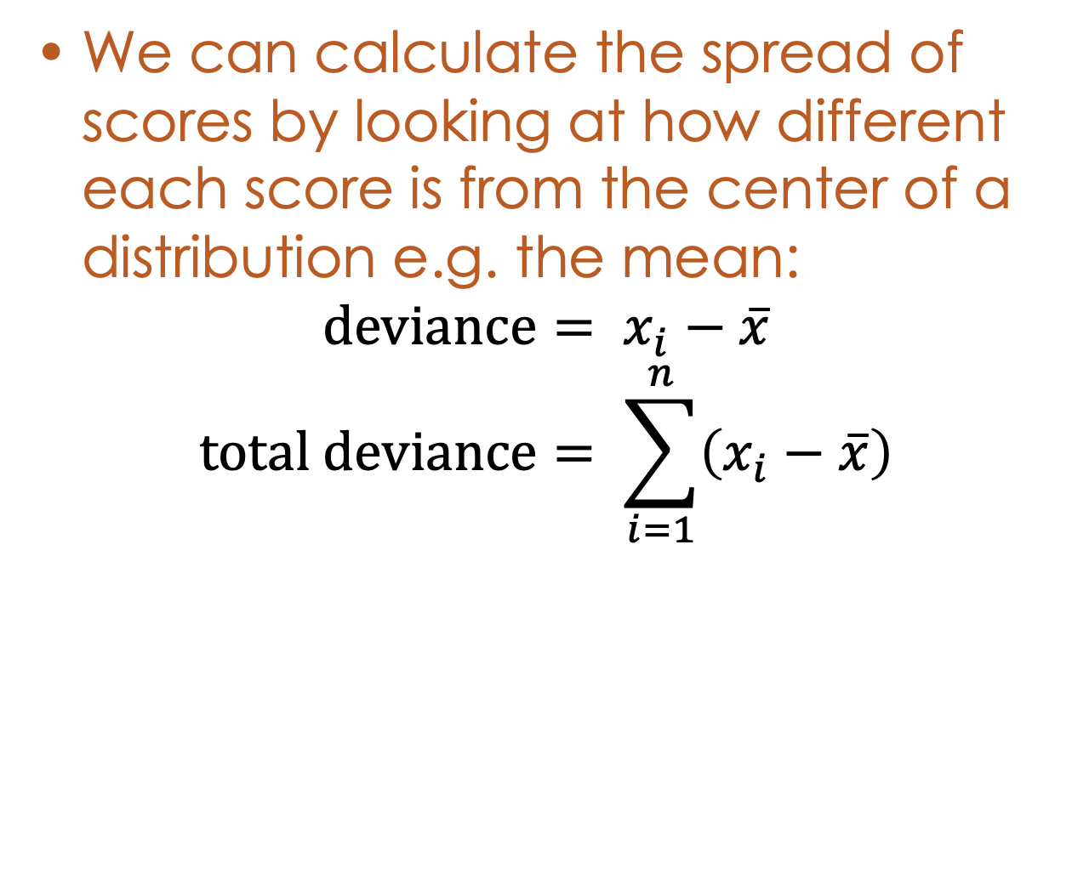
Deviance
We can calculate the spread of scores by looking at how different each score is from the center of a distribution e.g. the mean:
$$\text{d}\text{eviance}= x_{i}−\overline{x}$$
$$\text{total} \text{deviance}= \sum_{i=1}^{n}{\left(x_{i}−\overline{x}\right)}$$

Slide 21
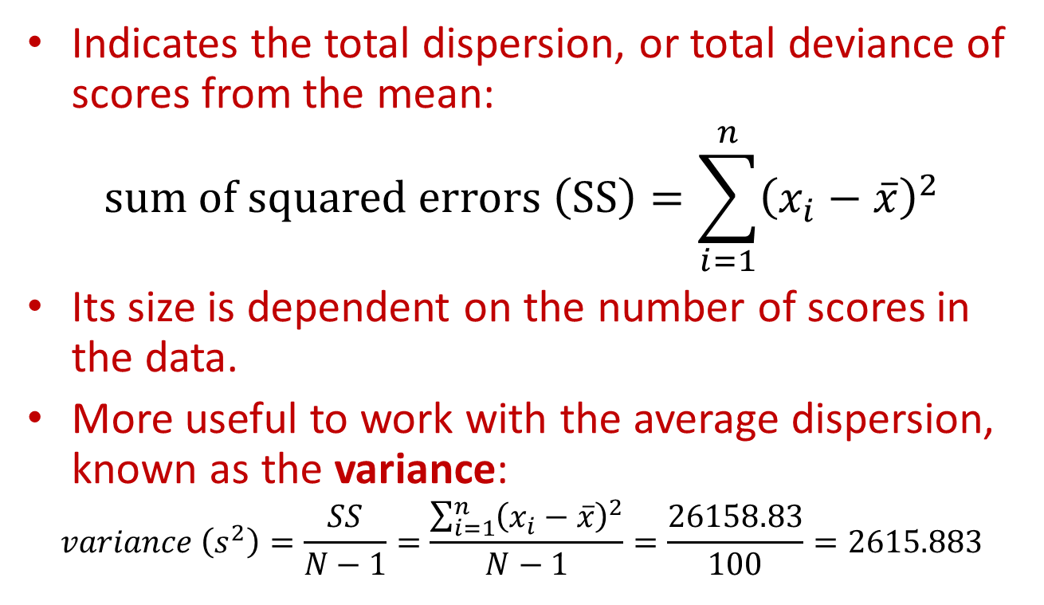
Sum of Squared Errors, SS
Indicates the total dispersion, or total deviance of scores from the mean:
$$\text{sum} \text{of} \text{squared} \text{errors} \left(\text{SS}\right)=\sum_{i=1}^{n}{{\left(x_{i}−\overline{x}\right)}^{2}}$$
Its size is dependent on the number of scores in the data.
More useful to work with the average dispersion, known as the variance:
$$variance \left(s^{2}\right)=\frac{SS}{N−1}=\frac{\sum_{i=1}^{n}{{\left(x_{i}−\overline{x}\right)}^{2}}}{N−1}=\frac{26158.83}{100}=2615.883$$

Slide 22
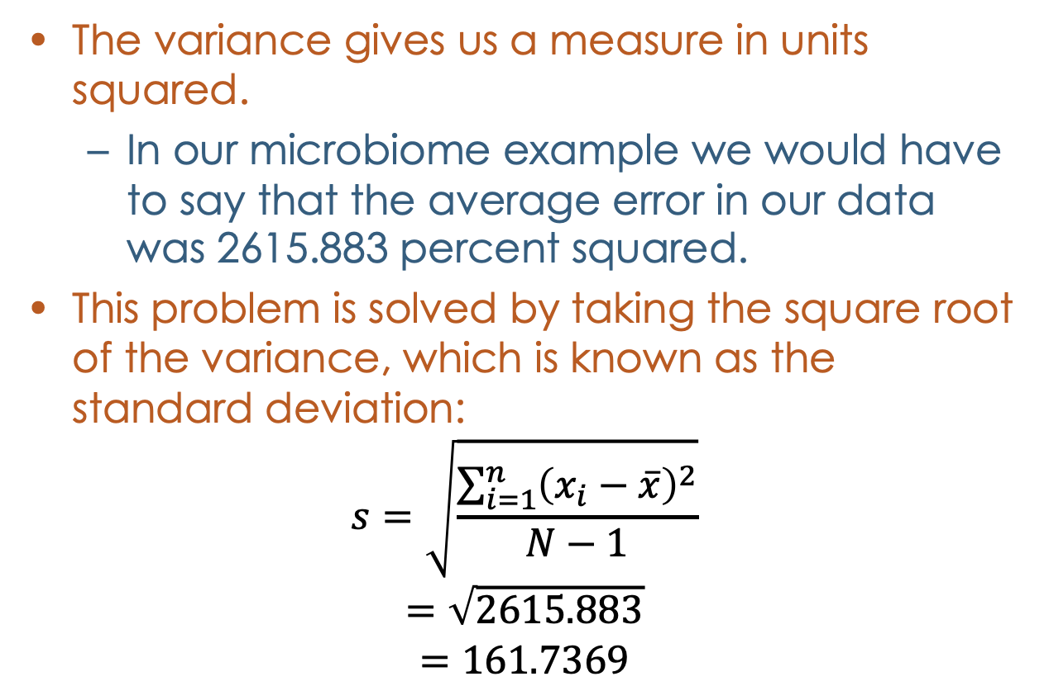
Standard Deviation
The variance gives us a measure in units squared.
In our microbiome example we would have to say that the average error in our data was 2615.883 percent squared.
This problem is solved by taking the square root of the variance, which is known as the standard deviation:
$$s=\sqrt{\frac{\sum_{i=1}^{n}{{\left(x_{i}−\overline{x}\right)}^{2}}}{N−1}}$$
$$=\sqrt{2615.883}$$
$$=161.7369$$

Slide 23
Using a Frequency Distribution to go Beyond the Data

Slide 24
Important Things to Remember
The Sum of Squares, Variance, and Standard Deviation are different ways to represent the same thing:
The ‘Fit’ of the mean to the data
The variability in the data
How well the mean represents the observed data
Error

Slide 25
Error Rates
Decide a drug/gene/etc. has an effect when it really doesn’t
Called Type I error or 𝛂
Traditionally set at 5% but can be smaller
Decide a drug/gene/etc. has no effect when it really does
Called Type II error or 𝛃
Often set at 20% but can be smaller
Type I error is generally worse than Type II error

Slide 26
P-Values and Confidence Intervals
P Value
Probability of making a Type I error
Does not give information on the precision of the estimates (it is a yes/no decision)
Alternative is to use confidence intervals
Interval around the estimate where we think the true value lies (it is a range of values)
Usually symmetric around the estimate, but does not have to be
For 95% confidence interval, if we repeated the experiment 100 times, we would expect 95 confidence intervals to contain the true mean

Slide 27
P-Values and Confidence Intervals
Ioannidis JP. JAMA. 2018;319(14):1429-1430

Slide 28
Confidence Intervals
Smaller confidence intervals indicate more precise estimates
Hypothesis: % of Bacteroides in gut flora = 50%
p < 0.001: reject the (null) hypothesis
This indicates the mean % of Bacteroides is not 50%, but does not tell us what the % is
Confidence interval for % Bacteroides in gut flora
95% confidence interval = (27.3, 33.8)
If another estimate (e.g., another experiment) has a smaller confidence interval, we would prefer the smaller confidence interval

Slide 29
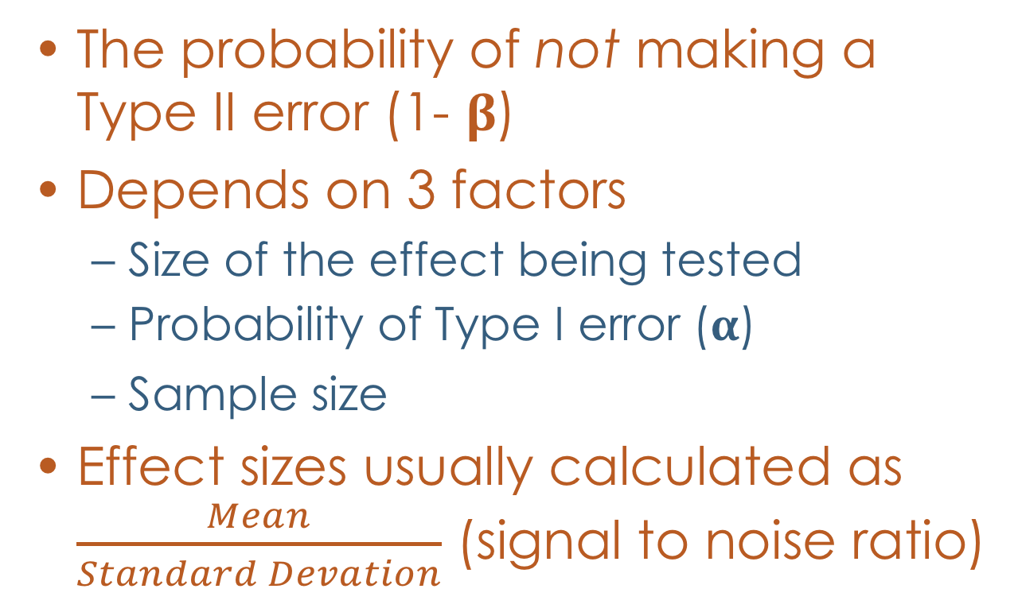
Power
The probability of not making a Type II error (1- 𝛃)
Depends on 3 factors
Size of the effect being tested
Probability of Type I error (𝛂)
Sample size
Effect sizes usually calculated as $\frac{Mean}{Standard Devation}$ (signal to noise ratio)

Slide 30
Effect Size
Effect sizes have been classified as ”small” (0.20), “medium” (0.50), and “large” (0.80) by Cohen
These effect sizes are often used in power calculations for many different types of statistical tests
Sometimes called “t-shirt effect sizes” because they overlook many details about an experiment

Slide 31
Effect Size
Think about it: for a “medium” effect size, you’ll choose the same n regardless of the accuracy or reliability of your instrument, or the narrowness or diversity of your subjects. Clearly, important considerations are being ignored here.
Russ Lenth
Department of Statistics
University of Iowa
(https://homepage.stat.uiowa.edu/~rlenth/Power/)

Slide 32
Summary
The normal distribution is critical for understanding statistical tests
Measures of central tendency and variability provide convenient summaries for data
Confidence intervals are useful for showing statistical significance and precision of estimates
Effect sizes are a convenient way to summarize the strength of findings, but have limitations

